Slide 1

Predicting Online Store Sales
Rita Suryani
https://www.linkedin.com/in/rita-suryani-91600b23a/
08 Oktober 2022

Slide 2
Data Understanding
The data source is from kaggle : USA online store transaction data
There are 11 features.
Transaction_date - Transaction date
Transaction_ID - This is a unique transaction id
Gender - Customer Gender
Age - Customer Age
Marital_status - Marital status about customer
State_names - Customer location of State.
Segment - Customer membership
Employees_status - Customer employment status
Payment_method - Payment method used by customer
Referal - Customer coming from referral link or not
Amount_spent - Amount spent by customer per transaction

Slide 3
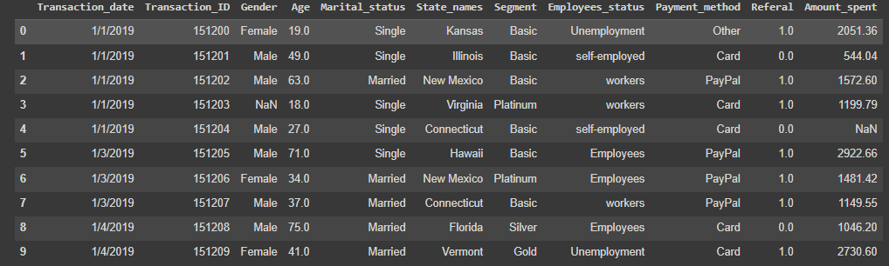
Data Overview
Categorical Data : 6 Columns
Numerical Data : 5 Columns

Slide 4
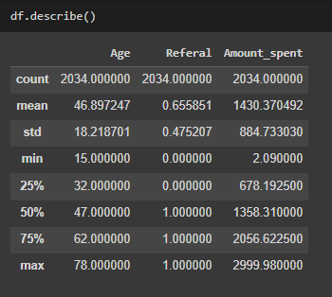
Umur tertua pembeli 78 tahun
Umur termuda pembeli 15 tahun
Rata- rata umur pembeli di 47 tahun
Total Belanja paling banyak di $2.999,98
Total Belanja paling sedikit di $2,09
Rata- rata $1.358,31

Slide 5
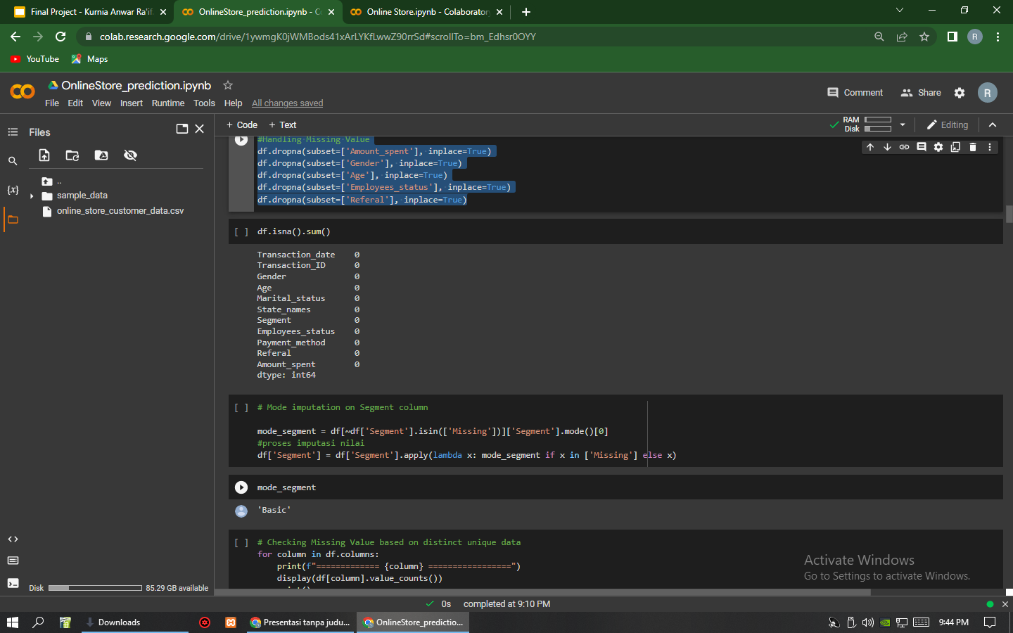
Data Cleaning
Handling Missing Value
df.dropna(subset=['Amount_spent'], inplace=True)
df.dropna(subset=['Gender'], inplace=True)
df.dropna(subset=['Age'], inplace=True)
df.dropna(subset=['Employees_status'], inplace=True)
df.dropna(subset=['Referal'], inplace=True)
Drop Duplicated
Duplicates in df : 12, (0.5%)
Before Drop duplicated data : ( 2512 , 11 )
After Drop duplicated data : ( 2500 , 11 )
# Mode imputation on Segment column
mode_segment = df[~df['Segment'].isin(['Missing'])]['Segment'].mode()[0]
# Proses imputasi nilai
df['Segment'] = df['Segment'].apply(lambda x: mode_segment if x in ['Missing'] else x)

Slide 6
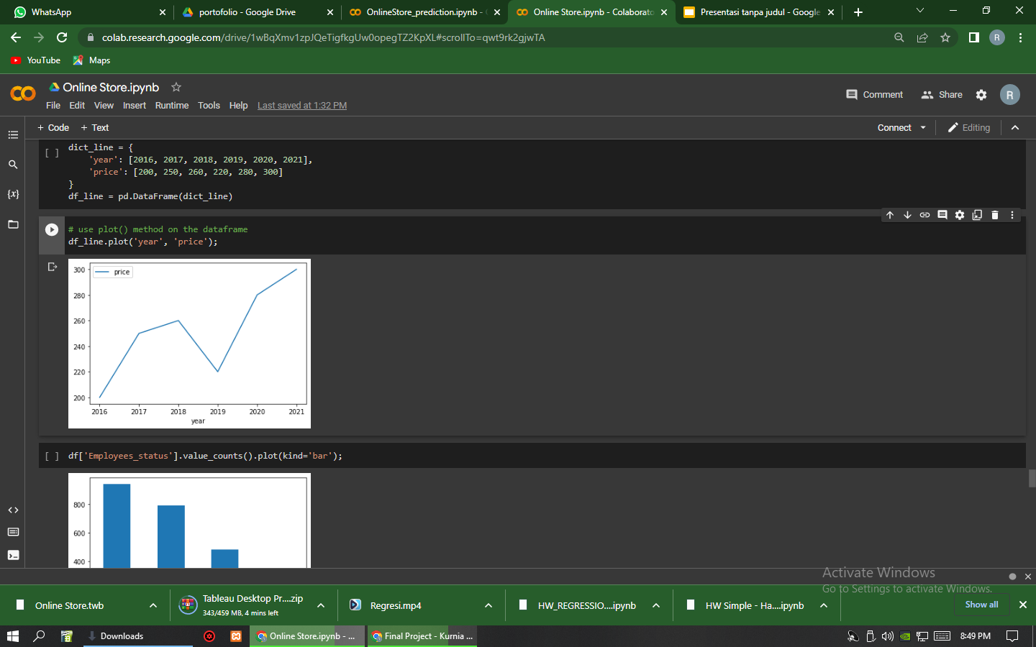
EDA | Numerical Data
Sales tertinggi di th 2021
Sales terendah di th 2019
th 2016 adalah awal pembukaan store

Slide 7
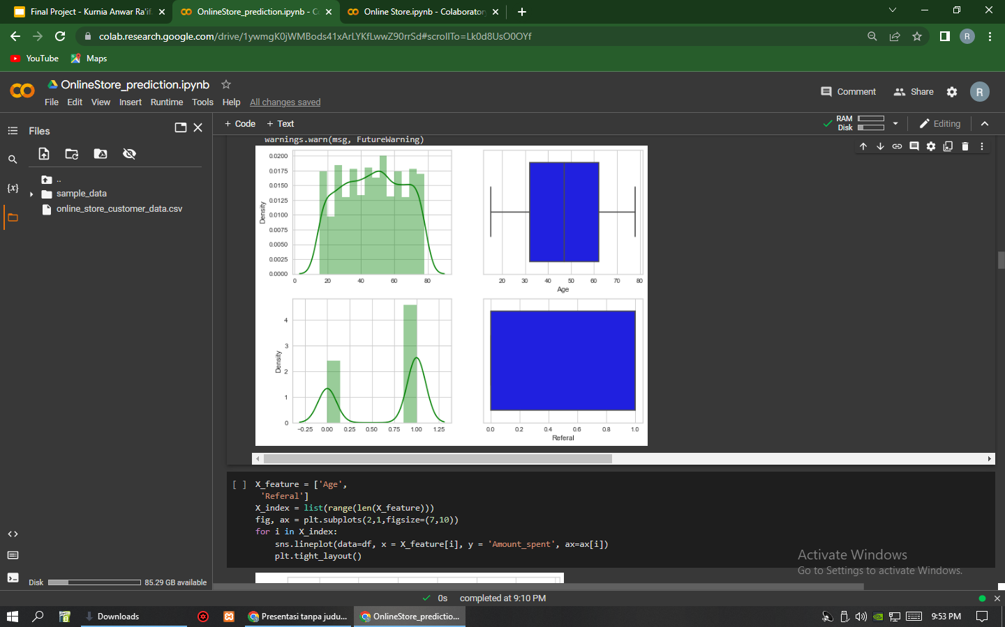
EDA | Numerical Data
Umur pembeli juga mempengaruhi pembelanjaan di Online Store
Rata- rata umur pembeli terbanyak di 47 tahun

Slide 8
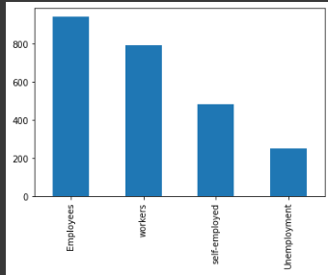
EDA | Categorical Data
Type pekerjaan sangat mempengaruhi dalam melakukan pembelian online
pembeli terbanyak adalah Employees
pembeli tersedikit adalah Unemployment

Slide 9
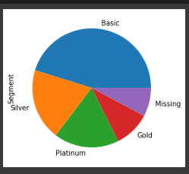
EDA | Categorical Data
Pembeli dalam segi segment terbanyak adalah Basic
Segment yang paling sedikit membeli adalah Gold
Terdapat Missing Value dan dapat ditangani dengan cara drop modus untuk data kategori sehingga Missing Value akan berubah menjadi Basic

Slide 10
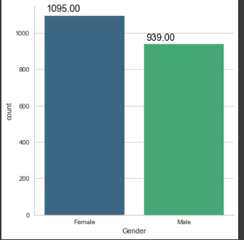
EDA | Categorical Data
Pembeli terbanyak adalah Perempuan
Pembeli Laki- laki hanya 939 dari 2034 pembelian
Male 46,16%
Female 53,84%

Slide 11
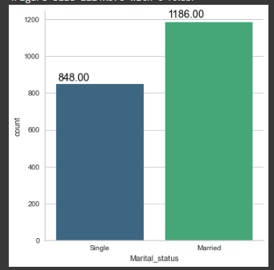
EDA | Categorical Data
Marital status juga mempengaruhi pembeli dalam melakukan pembelian
Pembeli yang sudah menikah lebih banyak dari pembeli yang Single
Single 41,69%
Married 58,30%

Slide 12
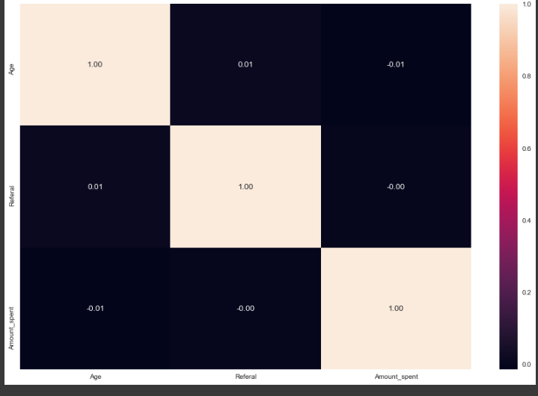
Check Correlation for each columns
Feature Selection

Slide 13
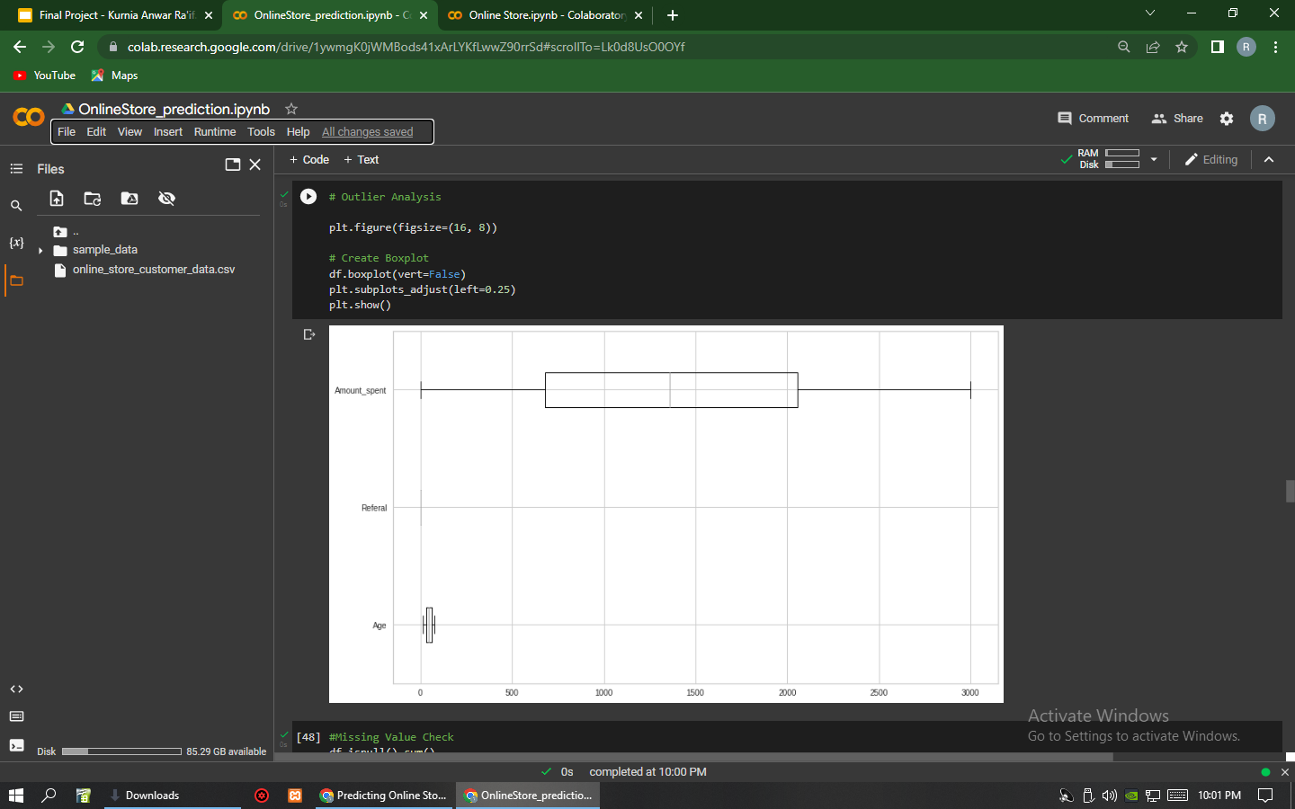
Prediction
Step 1
Split Dataset to 80:20
Step 2
Outlier Checking

Slide 14
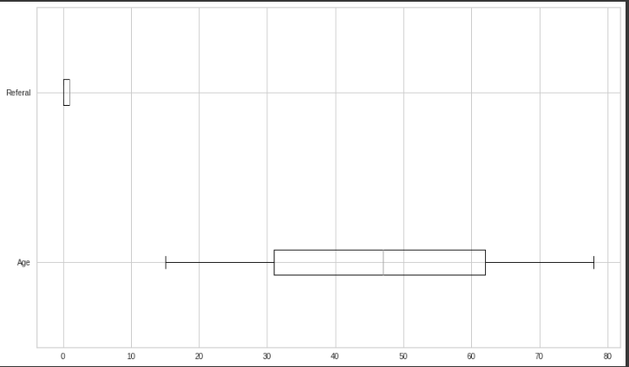

Slide 15
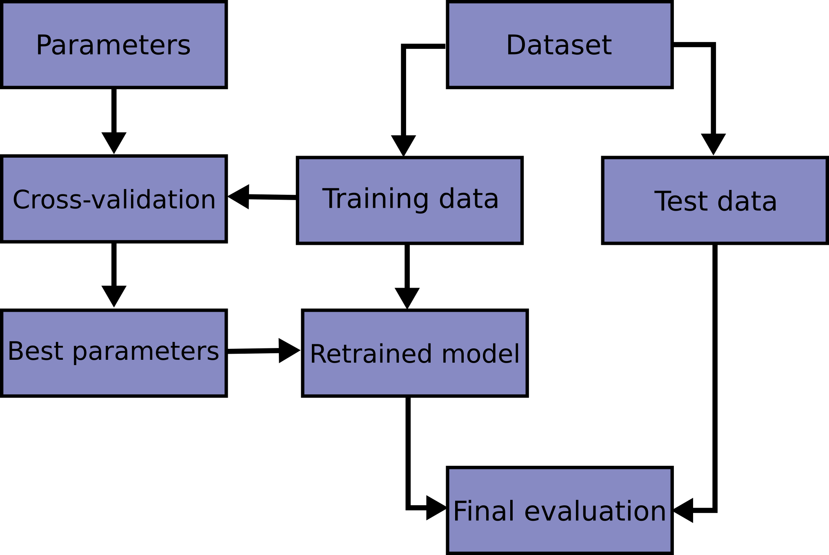
Step 3
Encoding Categorical Data
Step 4
Standardize Variabel (Feature Scalling > Transform)
Step 5
Fit In 3 Models on Training Data (lambdas = [0.01, 0.1, 1, 10]

Slide 16
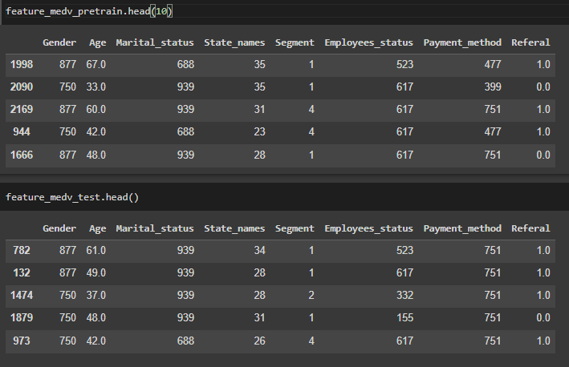
Encoding Categorical
Column with data categorical
Gender
Marital_status
States_names
Segment
Employees_status
Payment_method
DataFrame after Encoding

Slide 17
Fit Models on training data
Fit Models dengan Ridge Regression (lambdas = [0.01, 0.1, 1, 10])
Ridge Reg terbaik di alpha=10
Fit Models dengan Lasso Regression (lambdas = [0.01, 0.1, 1, 10])
Lasso Reg terbaik di alpha=10

Slide 18
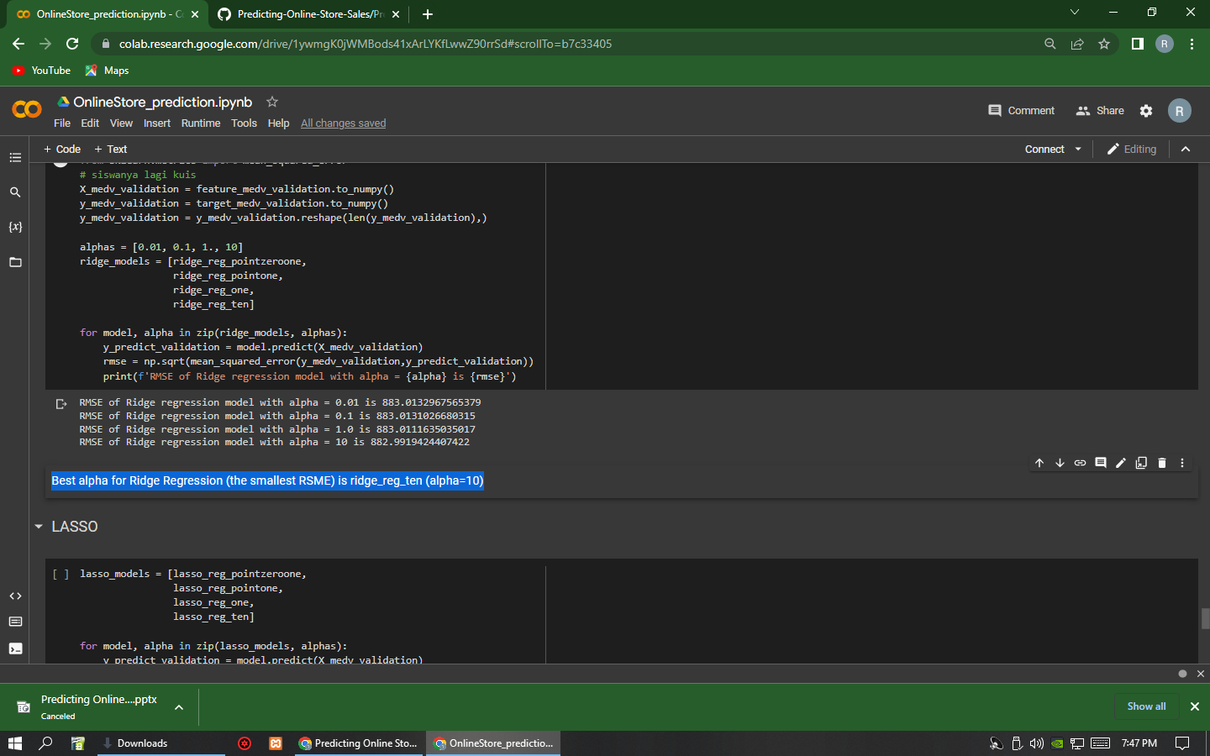
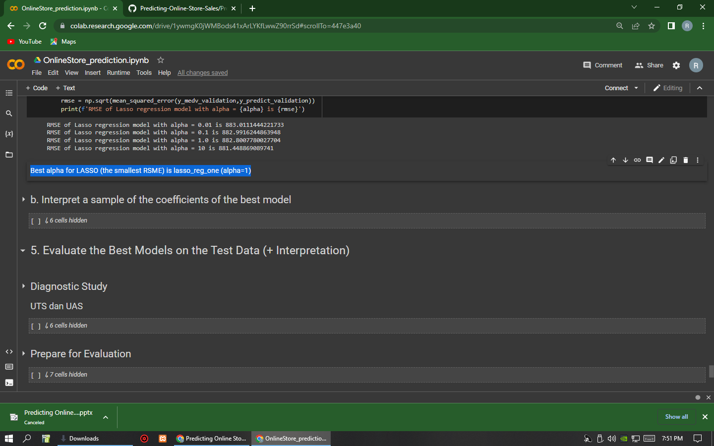
Choose the best Lambdas
Use RMSE as metric
Ridge
(Best alpha for Ridge Regression (the smallest RSME) is ridge_reg_ten (alpha=10)
Lasso
(Best alpha for LASSO (the smallest RSME) is lasso_reg_one (alpha=1))

Slide 19
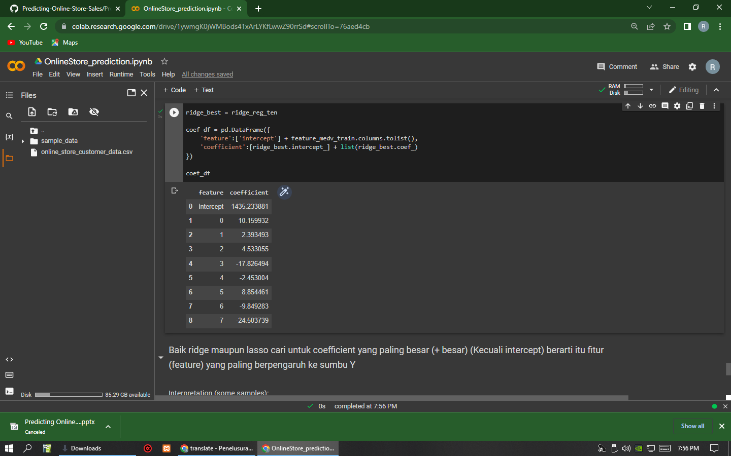
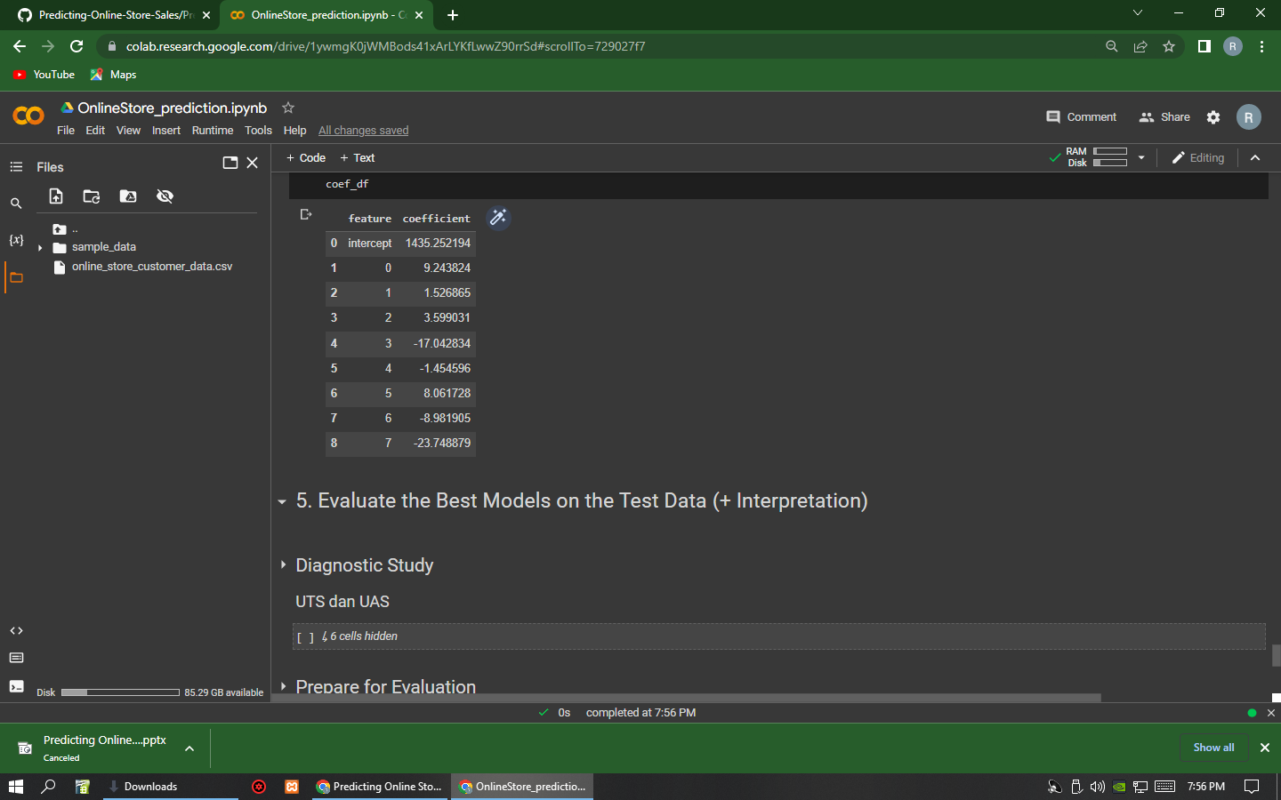
Interpret a sample of the Coefficients of the best Model
Ridge Regression
Lasso Regression

Slide 20
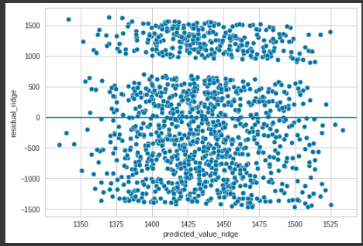
Evaluate the best Model on test Data
Ridge : R-square for training data is 0,17%

Slide 21
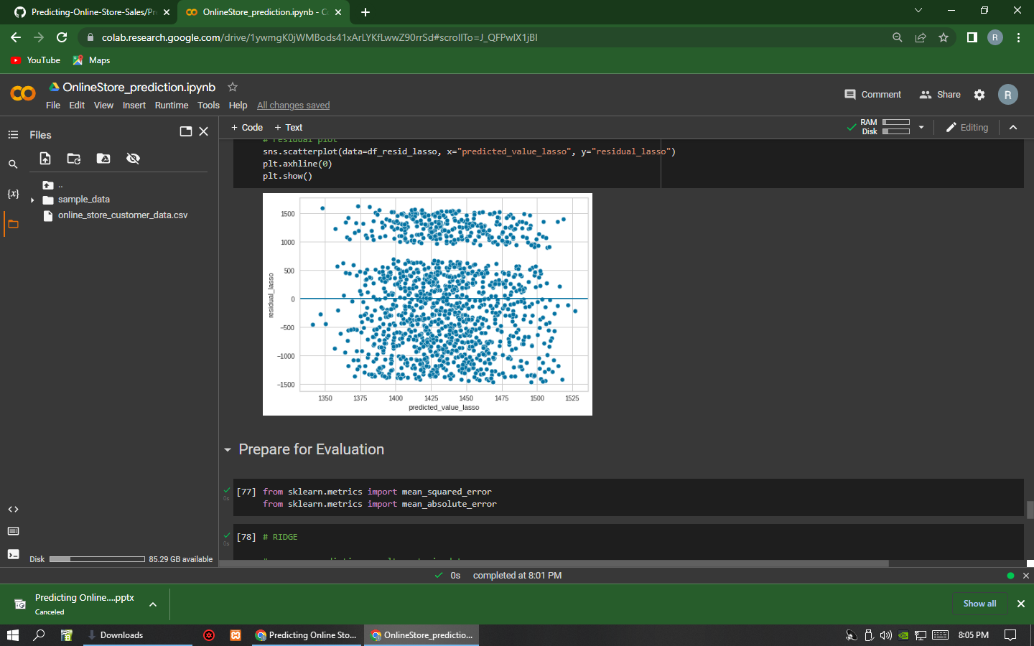
Evaluate the best Model on test Data
Lasso : R-square for training data is 0,17%

Slide 22
MAE
MAE Ridge for training data is 747.9139564549439
MAE Ridge for testing data is 793.9204370417691
Train MAE Ridge % 24.900166001106676
Test MAE Ridge % 26.464190995998944
MAE Lasso for training data is 747.926750101222
MAE Lasso for testing data is 793.6944611277792
Train MAE Lasso% 24.931057877093245
Test MAE Lasso % 26.45665841531541

Slide 23
MAPE
MAPE Ridge for training data is 382.4146122665313
MAPE Ridge for testing data is 430.4300609635075
Predict train data.mean 1435.6479554189086
Predict test data.mean 1439.4683688900775
Train MAPE Ridge % 12.747238723809204
Test MAPE Ridge % 14.347764350545923
MAPE Lasso for training data is 382.5376809248715
MAPE Lasso for testing data is 430.11629919652387
Train MAPE Lasso % 12.751341039769315
Test MAPE Lasso % 14.337305555254499

Slide 24
RMSE
RMSE Ridge for training data is 876.7299020874547
RMSE Ridge for testing data is 913.0885094740622
Train RMSE Ridge % 29.224524899747824
Test RMSE Ridge % 30.4364865590458
RMSE Lasso for training data is 876.7341347526803
RMSE Lasso for testing data is 912.8636881643878
Train RMSE Lasso % 29.224665989529274
Test RMSE Lasso % 30.42899246542936

Slide 25
Thank You
Special Thanks to :
All Mentor Dibimbing + Kak Kurnia Anwar Ra’if

